Slide 1
Data-driven journalism workflow with R
@duc_qn | Duc-Quang Nguyen 2017-06-16

Slide 2
Outline
SWI & data-driven journalism (ddj)
Why R?
Typical ddj workflow
DDJ examples from SWI with R
Scraping
API
Interactive data visualisations
Fluid graphics, gif

Slide 3
WTF is swissinfo.ch?
International service from the SRG-SSR
Previously, Swiss Radio International
Web-only, 10 languages, ~ 800K UCs / month
Editorially: Not focus on news, magazine. Explainer / background
DDJ mainly for explanatory journalism and data visualisations
“Data journalism increasingly relies on bespoke or technically complex datasets whose creation, curation or comprehension requires specialist data gathering skills and/or specialist data analysis skills and/or specialist data visualisation skills.”
John Murdoch, FT Data (http://johnburnmurdoch.github.io/slides/data-journalism-manifesto)

Slide 4

Why R?

Slide 5
Why R?
Open source
Large package ecosystem + integration with other tools (github, …)
Hooks to other programming languages (javascript, C++, …)
Awesome at data wrangling + static graphics (tidyverse)
Just great for DDJ :-) Standard tool for data wrangling by many.
Like Python

Slide 6
Why R?
Get data
Identify insights
Present Visually
Weave a data story
Typical ddj workflow
Books, OCR
pdf
spreadsheet
Scraping
API
Data wrangling & data analysis

Slide 7
Why R?
Get data
Identify insights
Present Visually
Weave a data story
Typical ddj workflow

Slide 8
Why R?
Single framework

Slide 9
DDJ examples with R

Slide 10
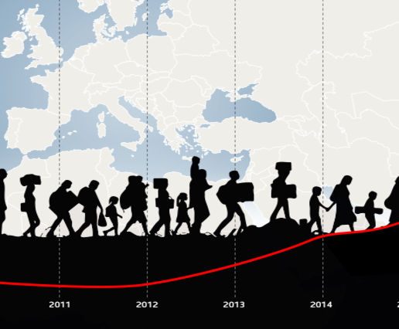
Are the Swiss too strict about the Dublin accords?

Slide 11
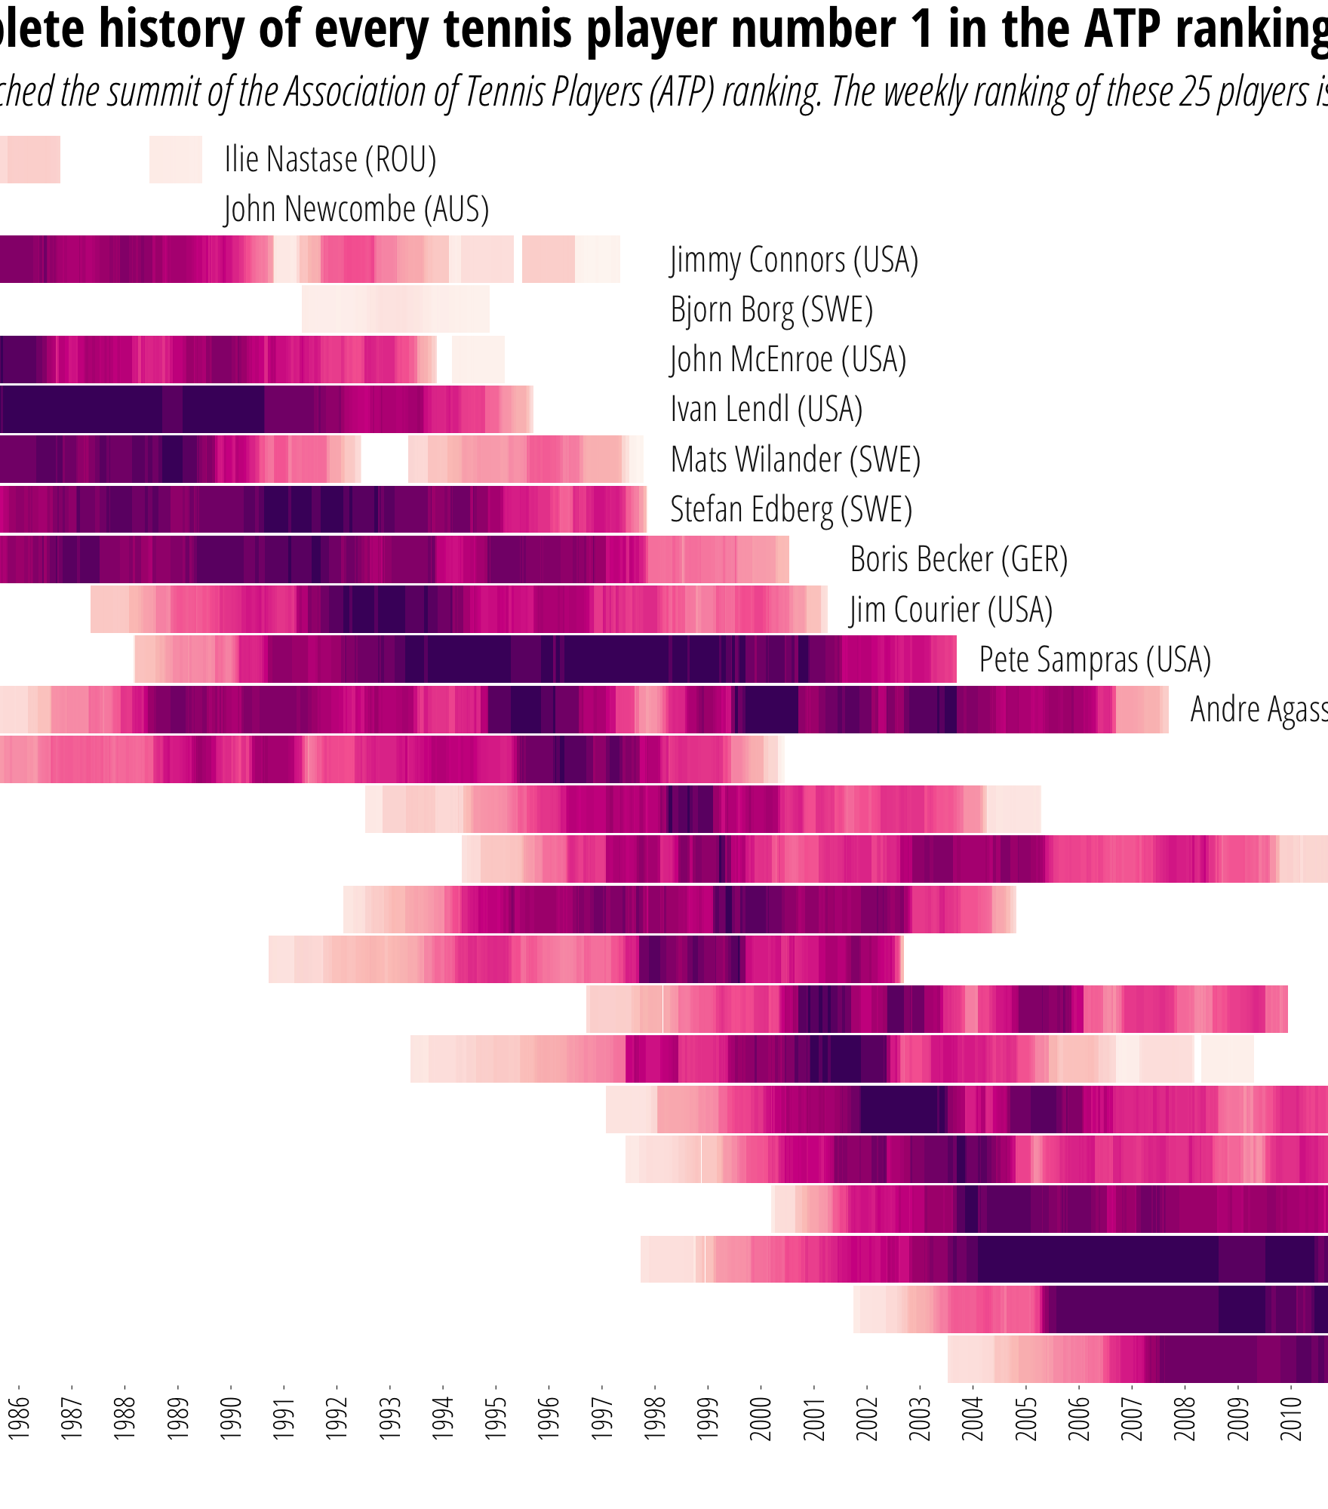
DDJ examples with R

